Slide 1
The Physical Internet

Slide 2
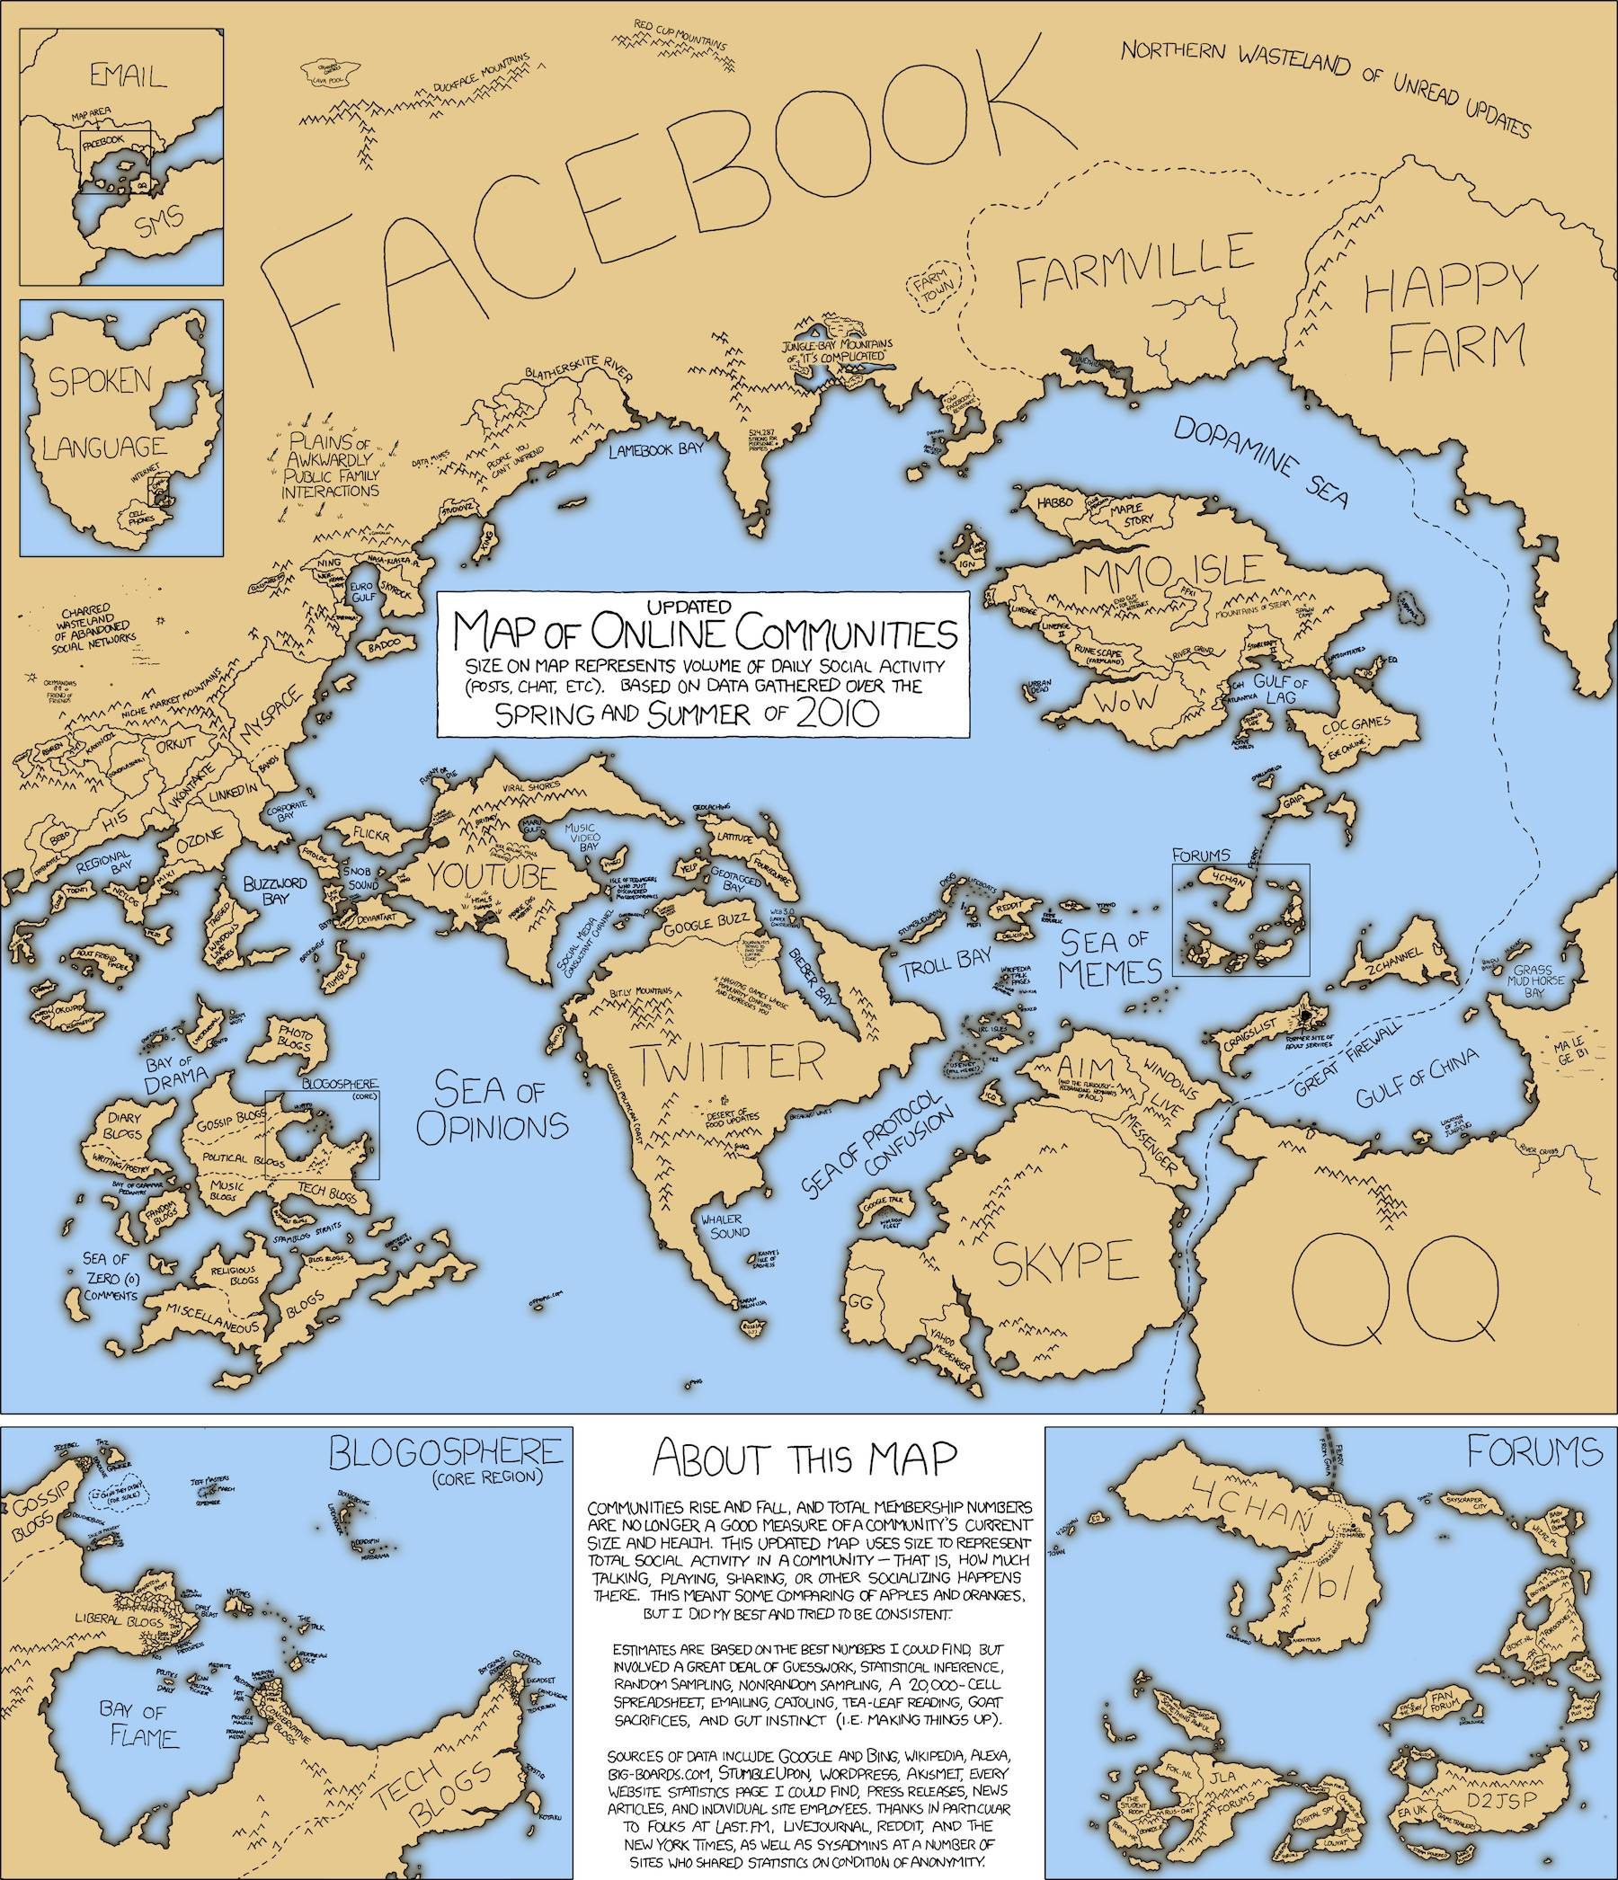
The Internet
What does it look like?
A network of networks
https://xkcd.com/

Slide 3
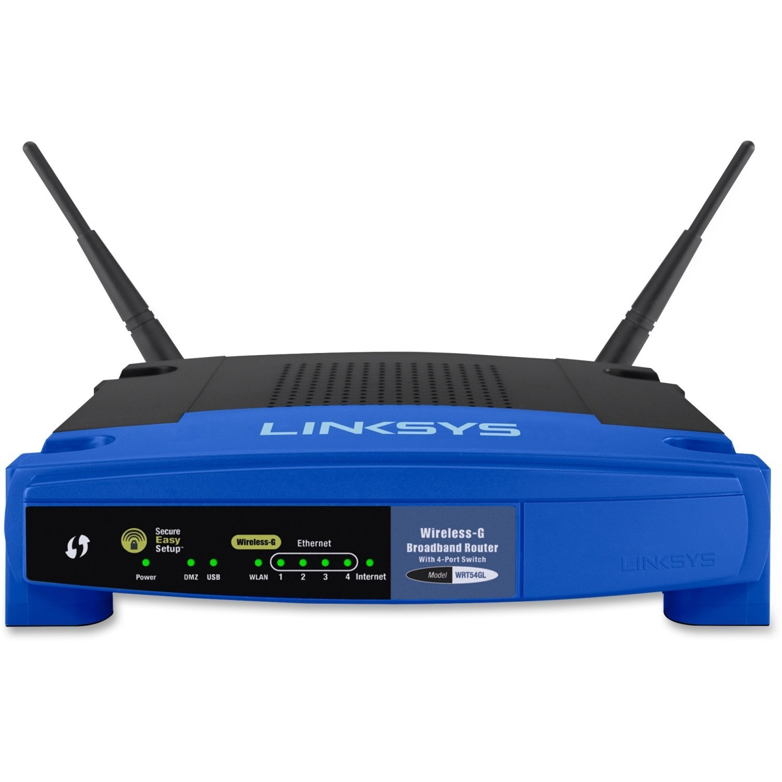
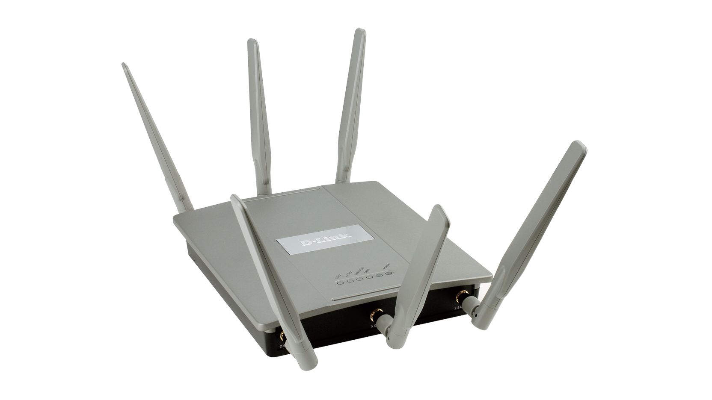
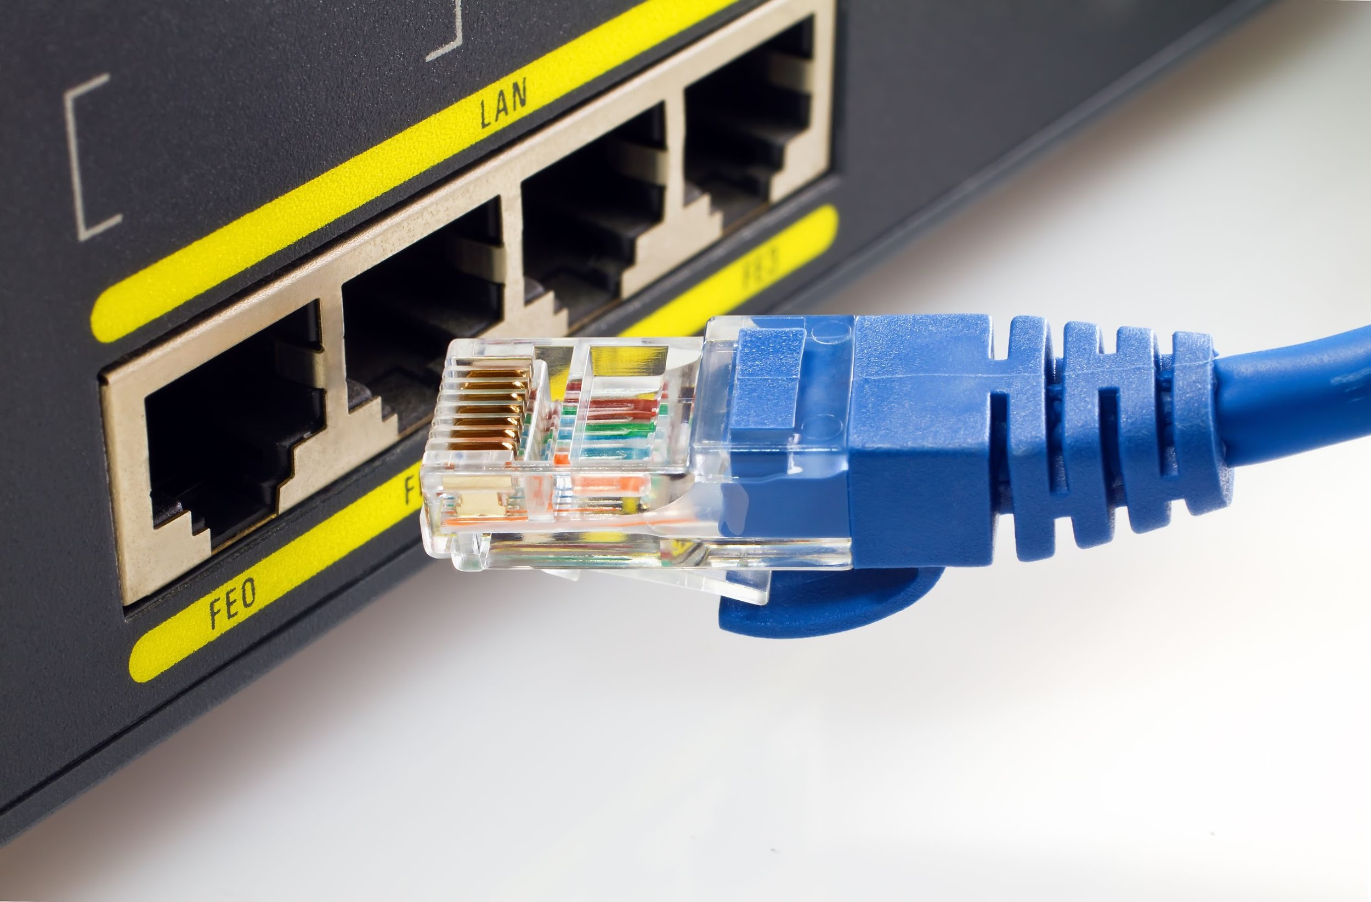
You (The End User)
Wireless Router
https://www.amazon.com/Linksys-WRT54G-Wireless-G-Router/dp/B00007KDVI
How do you connect to the Internet?
Wireless Access Point (WAP)
http://us.dlink.com/product-category/business-solutions/wireless/software-managed-access-points/
Ethernet
https://www.digitaltrends.com/computing/differences-between-ethernet-cables/

Slide 4
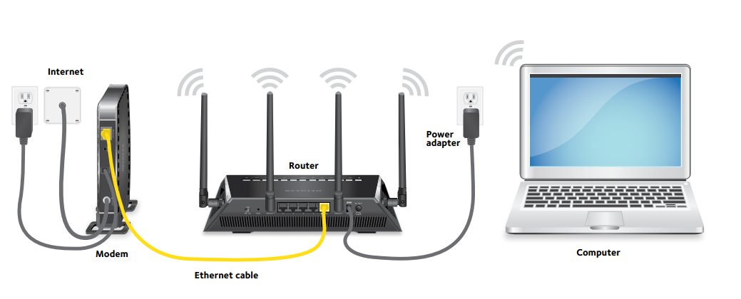
You
However you connect your machine to your network
you are connected to everyone else on that network
We often call this a Local Area Network (LAN)
Great for gaming will almost no lag
To connect to the Internet
Connect a router in the network to a larger network
Most commonly an Internet Service Provider (ISP) network through a modem
Router
Multiple devices can use the same connection
Modem
Decodes signals from ISP
https://kb.netgear.com/30985/How-to-manually-configure-a-PnP-connection-with-Etisalat-on-your-NETGEAR-Nighthawk-router

Slide 5
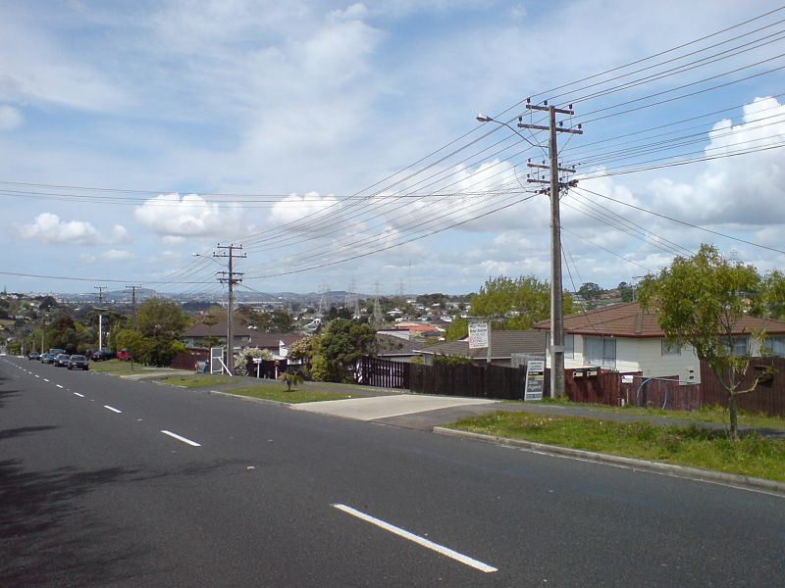
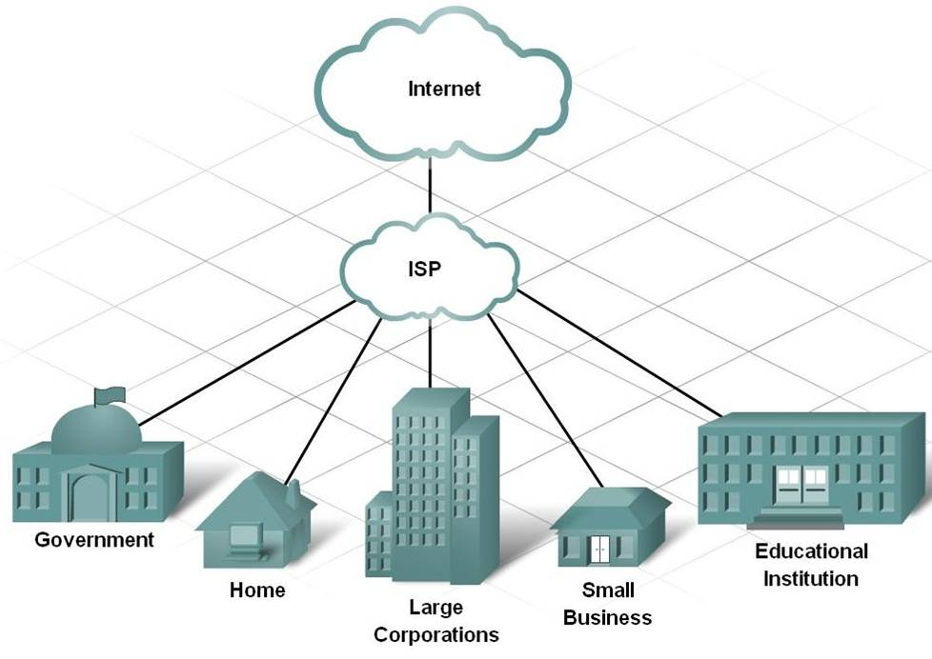
ISP Networks
http://oldforum.paradoxplaza.com/forum/showthread.php?837998-Underground-power-lines-and-capacity/page2
Connect customers to the Internet
Maintain city and regional networks
Addresses the last mile problem
Part of a network connecting to individuals
Requires onsite technicians for each connection
https://bijanghayyoomi.files.wordpress.com/2010/08/picture20.jpg

Slide 6
Tier 1 Networks
A network that is connected to all other networks on the Internet without paying another network provider for access
Maintain networks at the global scale
ISP’s pay for tier 1 access just like we pay ISPs
Tier one networks form the backbone of the Internet
Some tier 1 companies also offer ISP services to individuals in certain regions
Often peer with each other allowing them to use each other’s networks, thus increasing the overall speed and reliability of the Internet

Slide 7
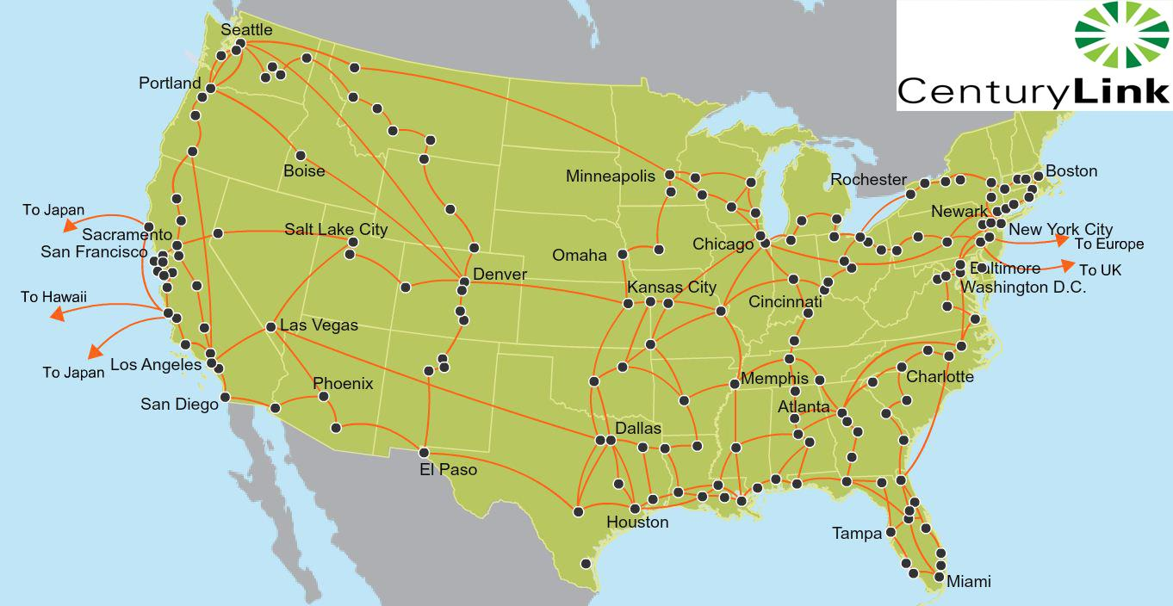
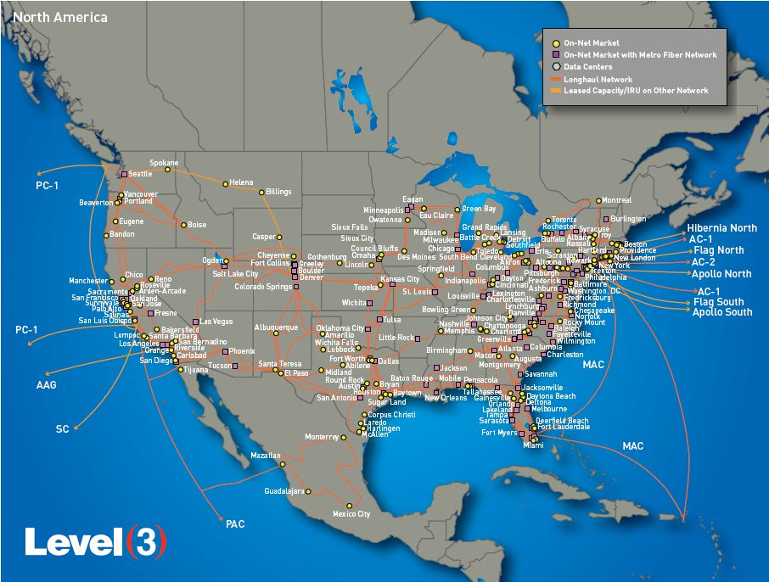
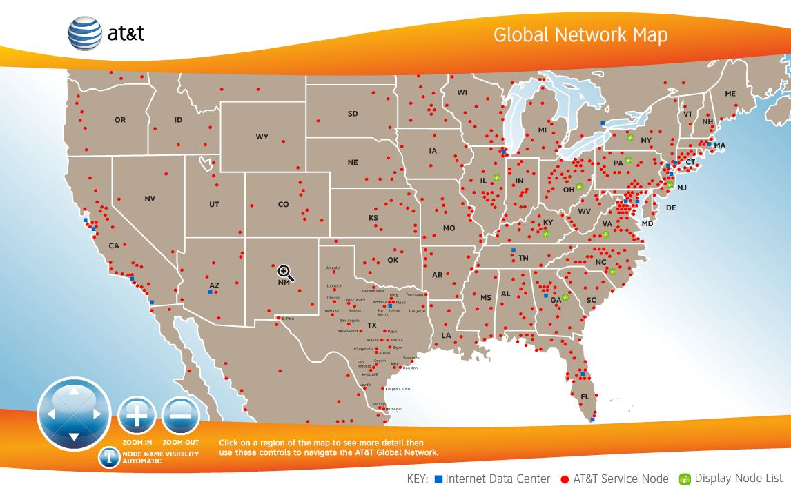
Tier 1 Networks
AT&T
CenturyLink
Global Telcon & Communications
Level 3 Communications
NTT Communications
Verizon Enterprise Solutions
Zayo Group
(https://en.wikipedia.org/wiki/Tier_1_network for more)
http://www.vootwerk.com/network.html

Slide 8
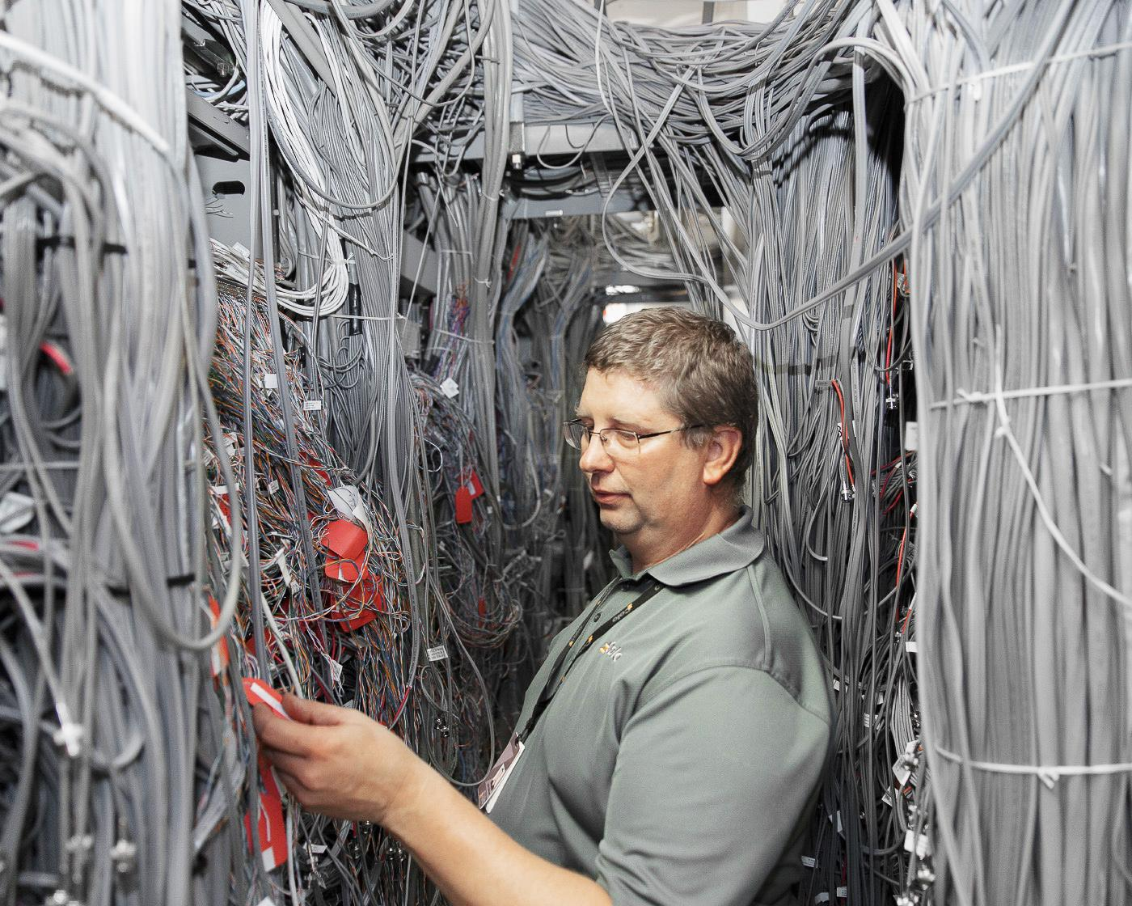

Internet Exchanges (IX)
Tier 1 networks must connect to ISP networks and other Tier 1 networks
These connections are made in Internet Exchanges
60 Hudson Street (pictured) houses one such IX in Manhattan
IXs maintain many connections and require reliable power and various backups
https://www.wired.com/2015/11/peter-garritano-where-the-internet-lives/
https://en.wikipedia.org/wiki/60_Hudson_Street

Slide 9
Connecting Continents
We routinely use the Internet to connect to people from around the world
This means our data is being routed across oceans to other continents
Discussion: How does this work?

Slide 10
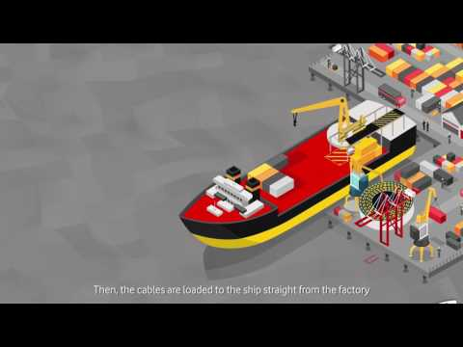

Slide 11
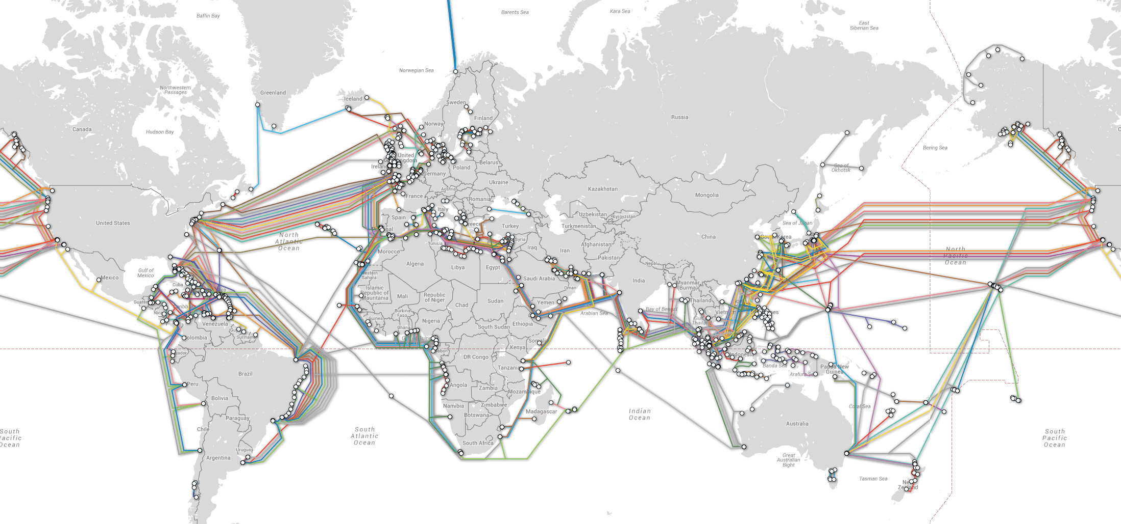
https://arstechnica.com/information-technology/2016/05/how-the-internet-works-submarine-cables-data-centres-last-mile/

Slide 12
First Submarine Cable
Spanned the Atlantic Ocean and Connected
Ireland
Newfoundland
Laid in 1858
Used to send telegraphs

Slide 13
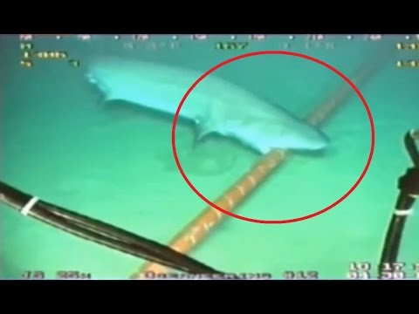

Slide 14
Content Delivery Network (CDN)
Everything we want to use needs to be connected to the Internet through networks
ISPs and Tier 1 networks route data through the Internet
CDNs connect the content we want to consume to the rest of the Internet
Large CDNs contain multiple sites in different parts of the country, or world
Increased speed
Don’t always to send a request to the company headquarters

Slide 15
CDN - Power and Storage
Popular CDNs have significant amounts of data to process
CDN receives many requests for data (Websites, snaps, streams, messages, etc)
Server
A computer designed to be housed in a server rack
Not made for personal use
Usually contains hardware specific to its role in the network
A CDN handling millions of users (ex. Twitter, Google, Amazon) needs many, many servers to maintain speed for every user
CDNs for popular services also store massive amounts of data
How much storage does Twitter need in order to store every tweet ever?
How about YouTube storing every video ever uploaded to the site?
Use server farms to store all this processing power and storage

Slide 16
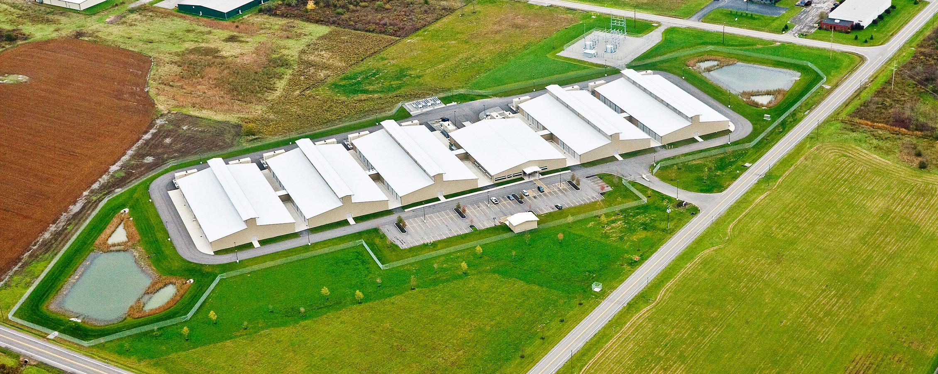
http://americanbuildersquarterly.com/2015/yahoo/

Slide 17
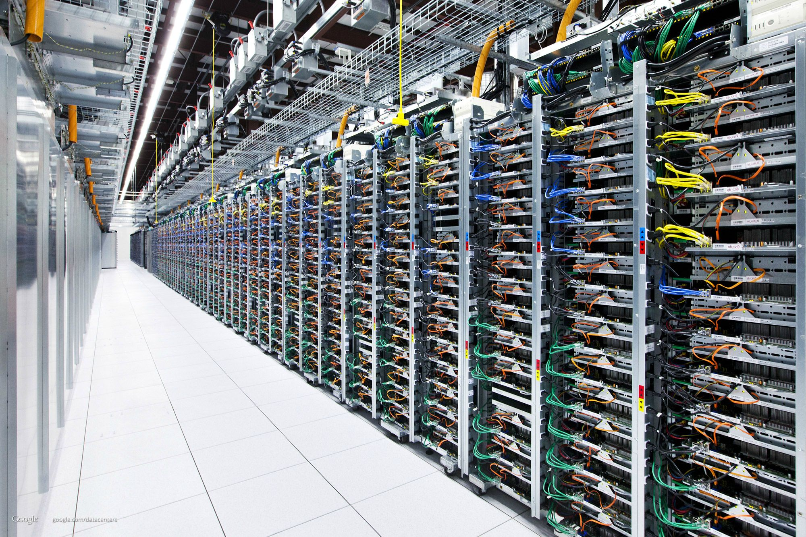
http://imgur.com/gallery/7NPNf

Slide 18
CDN - Bandwidth
Pay the ISP’s and Tier 1 companies to deliver their content
Similar to an end user, though bandwidth requirements can be huge
How much bandwidth does Google need in order to keep YouTube running?
How much bandwidth does Netflix need to stream to all of its customers?
Downsides
This can be extremely expensive!
Leaves CDN helpless in the case of network outages
Some companies lay their own cable to create CDN backbones
Increase bandwidth
Become more independent
Reduce long-term cost
Other networks deliver data to the CDN backbone. CDN delivers it to its destination

Slide 19
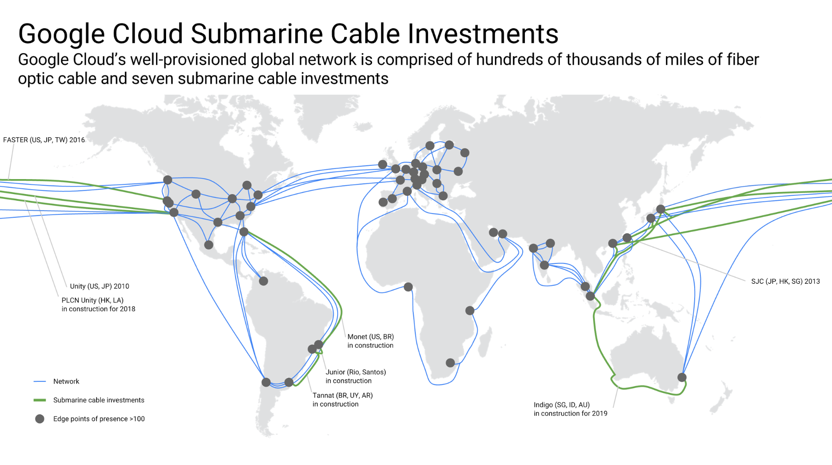
https://www.blog.google/topics/google-cloud/google-invests-indigo-undersea-cable-improve-cloud-infrastructure-southeast-asia/

Slide 20
TopHat

Slide 21
Net Neutrality
With Net Neutrality
ISPs must treat all data transfer over its network with equal priority
Without Net Neutrality
ISPs can prioritize certain data transfers however they choose
Can slow down requests made for certain CDNs
Can create “fast lanes” for CDNs at their will, or for profit
We currently have had net neutrality in the US
ISPs are fought relentlessly fighting to change this
They lobby lawmakers with our money
Some countries do not have net neutrality today
The Chinese government control much of what their citizens can access on the Internet
The Russian government requires ISPs to block certain sites or face fines
Australia has no laws in place to protect Net Neutrality and ISPs are free to do what they wish

Slide 22
Net Neutrality
The network (business) side
We’ve spent billions of dollars laying cable with the intent to make a profit
We should be able to earn that profit however we see fit
The user (human) side
The Internet has revolutionized the world
Do we risk slowing down civilization just to please the shareholders of a few companies?
Do we destroy the profits for countless other companies in the process?
Discussion: What do you think about Net Neutrality?

Slide 23
Discussion
On TopHat!

Slide 24
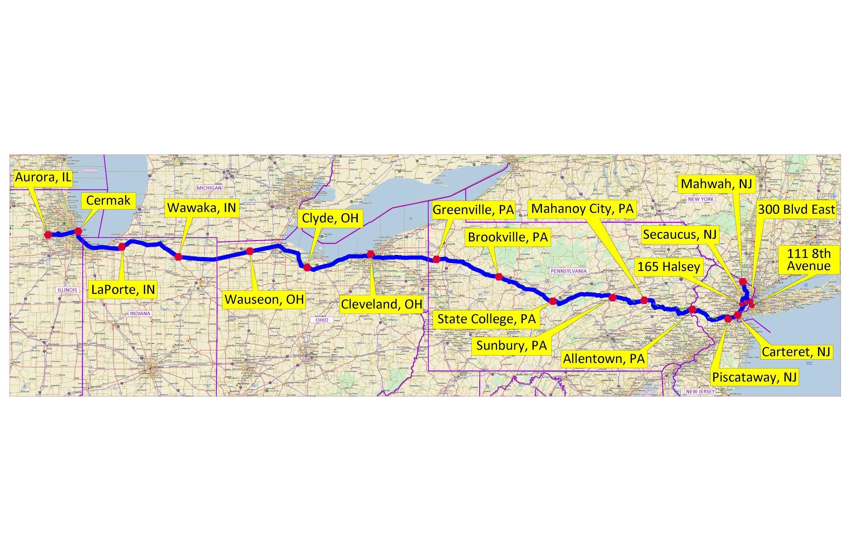
Spread Networks
What if ISP’s and Tier 1’s are not fast enough
http://spreadnetworks.com/network-map/

Slide 25
Spread Networks
Built a tunnel carrying fiber optic cable connecting Chicago and NYC
Cost hundreds of millions of dollars
Round trip time between the two cities
13ms (0.013 seconds)
Round trip time for a typical customers of ISP’s?
16ms (0.016 seconds)!
Read more: https://www.nytimes.com/2014/04/14/opinion/krugman-three-expensive-milliseconds.html

Slide 26
Spread Networks
Why fund a 9 figure project to save 3ms? Why these cities?
High volume trading
NYC
Home of the NASDAQ
Trade stocks
Chicago
Home of the Chicago Mercantile Exchange
Trade futures and options (Derivatives of stocks)
Arbitrage
Step 1: Detect a price discrepancy between a future or derivative and its underlying stock
Step 2: ??? (Probably a degree in finance)
Step 3: Profit!
Only one catch. You have to be first.
If 3ms is enough time to place your trade before anyone else, that’s YOUR profit!

Slide 27
Internet Protocol

Slide 28
Internet Protocol (IP)
We saw that the Internet is a network of networks connected by cables
Now, how do these networks and devices communicate with each other?
Don’t want to broadcast our data to everyone on the Internet
To connect to a specific server on the Internet we use the Internet Protocol
Official standard for IPv4: https://tools.ietf.org/html/rfc760
IP address
Every device connected to the Internet has an IP address
That device’s “location” on the Internet
To connect to specific device, send data to its IP address
Similar to send mail to a street address in the physical world

Slide 29
Internet Protocol
Data is sent in packets
Each packet contains a header and a payload
Header
Contains metadata about the packet
Most importantly, contains the source and destination IP addresses
Payload
The data to be send to the destination device
IP has no concern about the content of the payload
IP is only concerns about delivering the payload to its destination
Payload often/always follows additional protocols agreed upon by the source and destination
Ex: TCP, UDP, HTTP
Payload is often encrypted

Slide 30
IP
Address of a machine on the Internet
Ex: 172.217.12.211
Routers read the address and send it to the next step
Often read a prefix
IPs with a common prefix are related
Two parts: Network, host
Organizations will receive a prefix and own all IP’s that start with that prefix
One of Google’s ranges: 172.217.0.0-172.217.255.255
Network prefix: 172.217.x.x

Slide 31
IP
IPv4 (8.8.4.4)
Consists of 4 numbers ranging from 0 to 255
How many total addresses?
4 numbers, 8 bits each, 32 total bits, 2^32 total addresses
4,294,967,296
A lot, but not enough
IPv6 (2001:4860:4860:0000:0000:0000:0000:8844)
128 bit addresses
2^128 total addresses
340,282,366,920,938,463,463,374,607,431,768,211,456
That should be enough
Used in conjunction with IPv4
Routers must be able to route both versions

Slide 32
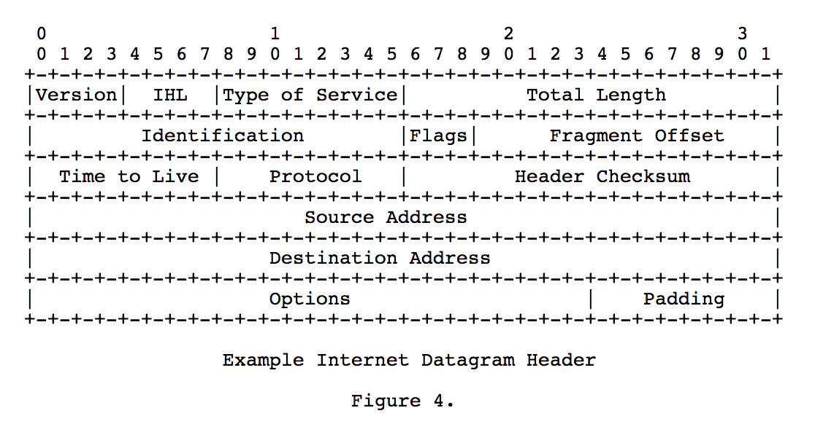
From the IPv4 official standard: https://tools.ietf.org/html/rfc791

Slide 33
Domain Name Service (DNS)
We don’t want to remember IP address for all our favorite sites
With DNS, we don’t have to
DNS
Remember a Domain Name instead of an IP address
Domain Name: google.com
When you click a link, first a DNS request is made to get the IP address for that Domain Name
Then the IP address is used to make your request
Can access sites directly by IP
http://172.217.6.228/
Not all sites allow direct IP access
http://104.16.40.2/

Slide 34
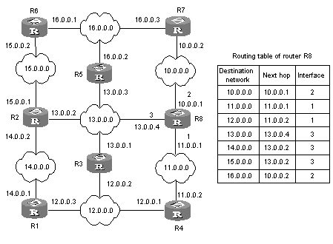
Routing Through the Internet
ISP and Tier 1 networks contain many routers to direct Internet traffic
These routers are made for speed!
To maximize speed, they are simple
The complexity of the Internet is in the users and CDNs
Router reads the destination IP address of a packet and sends it to the next router
Only knows the next step
No one needs to map the entire Internet
Networks change
Routing tables can be updated
https://superuser.com/questions/959242/how-is-next-hop-defined-in-routing-table

Slide 35
Transmission Control Protocol (TCP)
The Internet is unreliable
Router sends a packet to its next step, then forgets about it
May have sent packets to a failed router
Cables may be cut
Regions can have power outages
Router never gets confirmation of delivery even if the packet made it to its destination
Internet users and CDNs are responsible for reliability
How?
Timeout
TCP

Slide 36
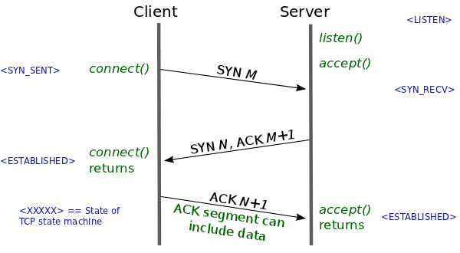
TCP: Making a Connection
3-way handshake to confirm a connection
SYN
Client sends a packet with a random number to the server
SYN-ACK
Server acknowledges that it received the client’s SYN by returning the random number+1
Also send another random number
ACK
Client returns the server's random number plus 1
After all three steps, boths side have verified the connection
https://lwn.net/Articles/508865/

Slide 37
TCP: Transmitting Data
Data is often too large for a single packet
Divide data into smaller packets
Receiver reassembles the packets on the other side of the Internet
Once a connection is established, send all the packets
Packets can arrive out of order
Each packet contains a sequence number for reordering
If a sequence number is missing, request a resend
Many streams simultaneously
TCP uses port numbers
Port number routes communication at the machine level
Different programs communicate with different ports
Allows multiple programs to all use the Internet
Ex: Web browsers use ports 80 and 443

Slide 38
Live Demos
How long does it take to load a website? (Browser console)
What’s the path of a packet? (Traceroute)

Slide 39
A Thought on Security and Privacy
How to secure your data and protect your privacy?
Encryption!
More later
No matter how you encrypt your data, your ISP and Tier 1 networks must always know 2 things:
Source IP Address
Destination IP Address
Therefore: They HAVE to know what servers you’re connecting to, even if they don’t know what you are saying

Slide 40
A Thought on Security and Privacy (VPN)
Virtual Private Network (VPN)
Originally used to connect to a network remotely (ex. UB’s AnyConnect)
Commonly used to “Bounce” web requests off the remote server
The VPN can send requests on your behalf and return the response to you
Can increase privacy
Can effectively scramble communication if many users go through the same VPN
Does not ensure privacy
Must trust the VPN provider
Routers still know you’re connecting to a VPN
CDNs can block traffic from known VPN IP addresses
Important: This is not a violation of net neutrality since CDNs are not ISPs!

Slide 41
Course Evaluations

Slide 42
Please Give Us Your Feedback
For your extra 3 points, both need to be 80% or higher.
Check your email for the link to CSE 199 survey.
Both close on 12/9 (this Sunday).
The winning section for extra 2 points is A at this point.
 | University Course Evaluation | CSE 199 Survey
Section A | 37% | 30%
Section B | 50% | 15%
Section C | 46% | 13%
Section D | 36% | 13%
Section E | 43% | 13%
Section F | 51% | 13%

Slide 43
HTTP

Slide 44
How did we get here?
The physical Internet
The Internet is a network of networks
Physically connected by cables and routers
Internet Protocol (IP)
How routers move data through the Internet
Best effort basis
Transport Control Protocol (TCP)
Transport information reliably through an unreliable network
Used by the client and server

Slide 45
Network Stack
Enter HTTP
Packet Structure
IP
TCP
HTTP
Content

Slide 46
HyperText Transfer Protocol (HTTP)
HTTP is an Application Protocol
Protocols that are not concerned with the transmission of data
Standards for what we do with the data
Used to access data, web sites, and web apps
[Almost] Always uses TCP for reliable communication

Slide 47
HTTP: Client - Server
HTTP add structure to the communication between a client and a server
Request - Response protocol
Client makes request to server
Server returns a response
Ex. Request The latest tweets from a user. Twitter server returns the tweets in its response
Response can require more requests
Each image on a web site requires another request
Required libraries need to be downloaded (JQuery, Bootstrap)
Can contain links that make other requests

Slide 48
HTTP
HTTP is a stateless protocol
Saves time and memory on the server
Each request is handled in isolation even if a client just made another request
If state is desired (ex. Login) it must sent the state with each request
Cookies
Tokens

Slide 49
Response codes
200 OK
Request was handled as expected
301 Moved Permanently
Redirect to the new location
304 Not Modified
File in local cache can be used
403 Forbidden
You don’t have access to the requested page
404 Not Found
Requested data could not be found
500
Internal server error

Slide 50
URL
Structure:
Protocol://server_name/resource
Protocol
Ex: HTTP
Server name
Ex: buffalo.edu
Resource
Ex: home.html

Slide 51
HTTP Requests
GET Request
Request information from a server
POST Request
Send information to a server (Forms)

Slide 52
Security
Client downloads the entire code for a site and you run it in your browser
The client has all the code needed to run the site in their browser. Clients can make any changes they want!
JavaScript console. Edit html. Edit requests directly.

Slide 53
Security
Server must verify every request
Never trust your clients
DRM? Always online replaced older drm. Anything client side will eventually be cracked

Slide 54
Security and privacy
ISPs, tier 1, local network owners, and everyone in range of your WiFi can read your stuff!

Slide 55
HTTPS
Encrypted version of HTTP
Privacy
You verify the server’s identity
Server verifies your identity
Signified by a green lock on most browsers

Slide 56
Who to Trust
Certificate authority. Must trust the CAs. In the end, all security comes down to trusting someone. In this case you trust your browser, the CA, the site you're using.
More likely, you trust that if these large organizations we're doing something wrong that someone else would call them out for you
Even with trust, are they competent?
Remember: others still know who you're talking to, but not what you're saying. They can also know how much you are talking

